Slide 1


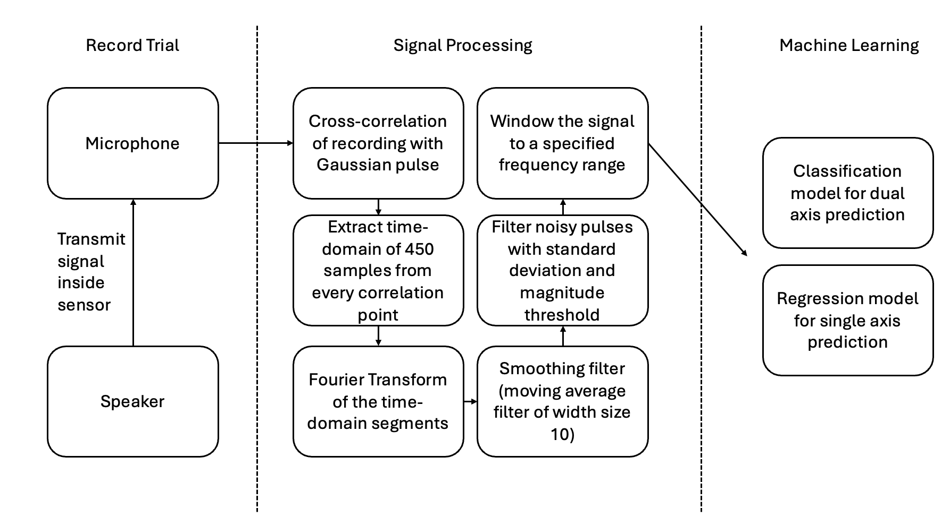
Signal generation
Tactile sensor
Classification
Buffer
Fast Fourier Transform
Load model
Transmit prediction
Consecutive key check
Simulate keypress
Regression
Window result
Smooth signal
Signal processing
Machine learning
Socket server

